Slide 1
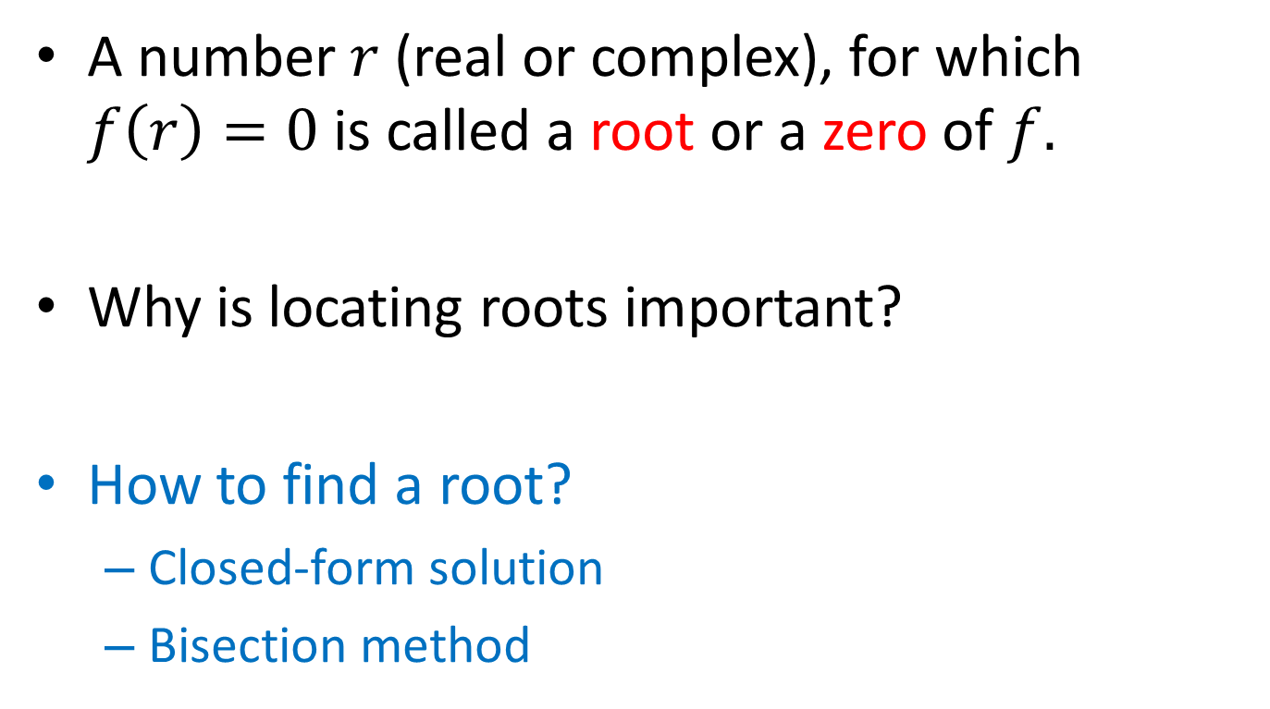
Root finding
A number $r$ (real or complex), for which $f\left(r\right)=0$ is called a root or a zero of $f.$
Why is locating roots important?
How to find a root?
Closed-form solution
Bisection method

Slide 2
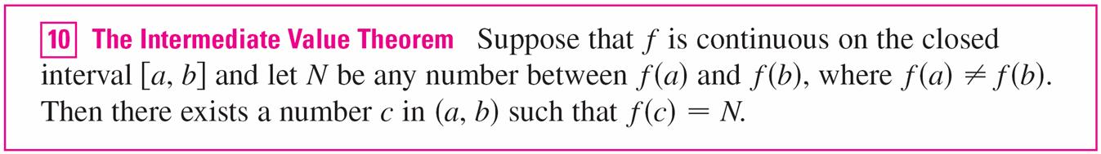
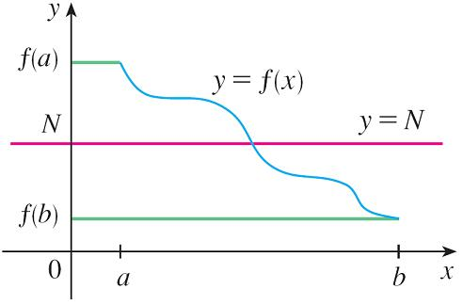
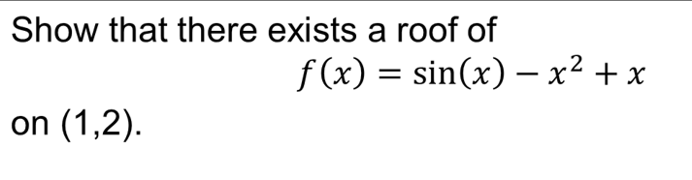
Intermediate Value Theorem

Slide 3
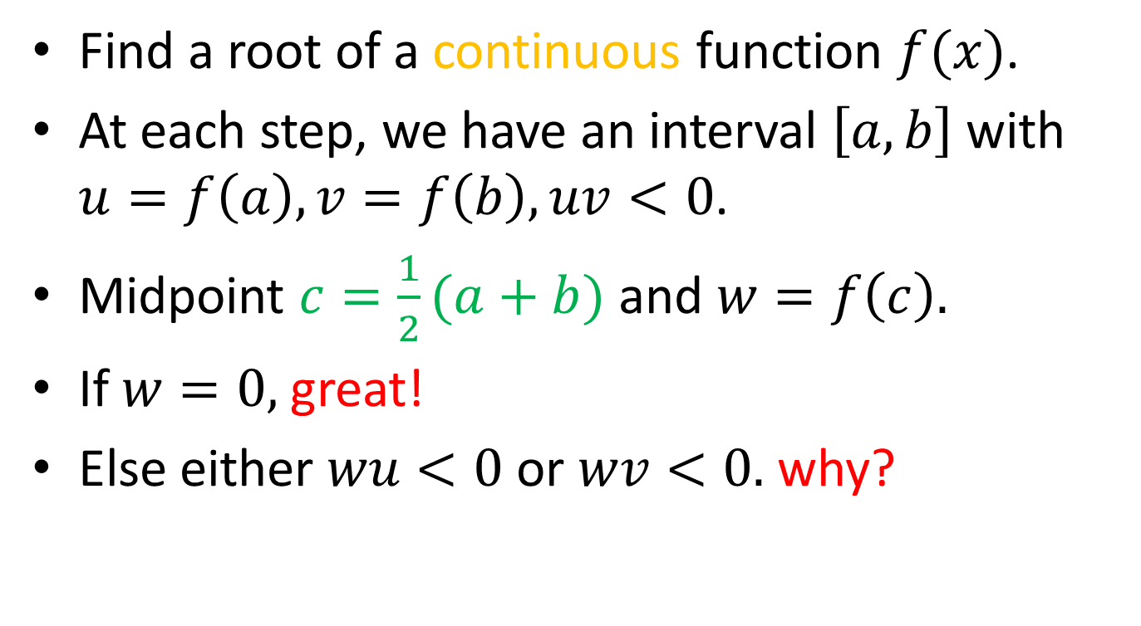
Bisection method
Find a root of a continuous function $f(x)$.
At each step, we have an interval $\left[a,b\right]$with $u=f\left(a\right), v=f\left(b\right), uv<0$.
Midpoint $c=\frac{1}{2}(a+b)$ and $w=f\left(c\right).$
If $w=0,$great!
Else either $wu<0$or $wv<0.$ why?

Slide 4
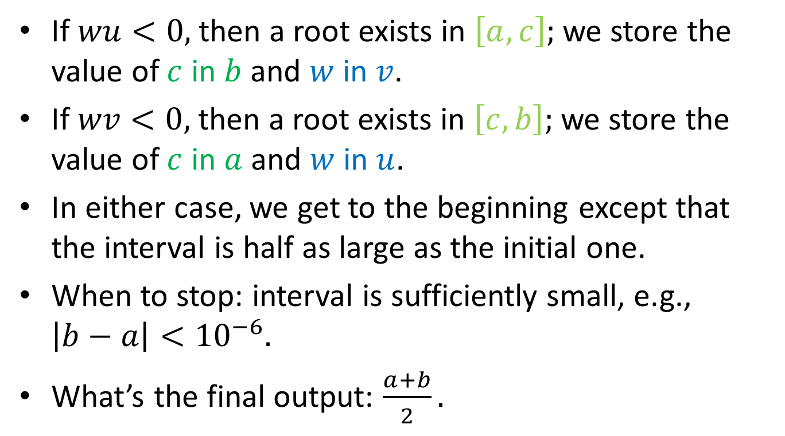
Bisection method (cont’d)
If $wu<0,$ then a root exists in $\left[a,c\right];$ we store the value of $c$ in $b$ and $w$ in $v$.
If $wv<0,$ then a root exists in $\left[c,b\right];$ we store the value of $c$ in $a$ and $w$ in $u$.
In either case, we get to the beginning except that the interval is half as large as the initial one.
When to stop: interval is sufficiently small, e.g., $\left|b−a\right|<{10}^{−6}.$
What’s the final output: $\frac{a+b}{2}.$

Slide 5

Pseudocode
Input: $f\left(x\right), [a, b]$ (initial interval)
Output: $r$ satisfies $f\left(r\right)=0$

Slide 6
Remarks
Any function value that may be needed later should be stored rather than recomputed.
Always have stopping conditions in place to avoid endless loops.
Avoid using == and ~=
Underflow/overflow may arise.
Trace the steps in routine to see it does what is claimed.

Slide 7

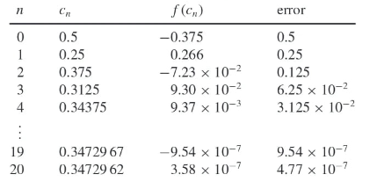
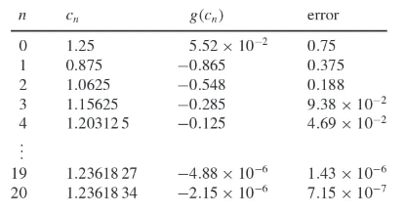
Numerical examples

Slide 8
Convergence analysis

Slide 9
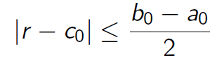
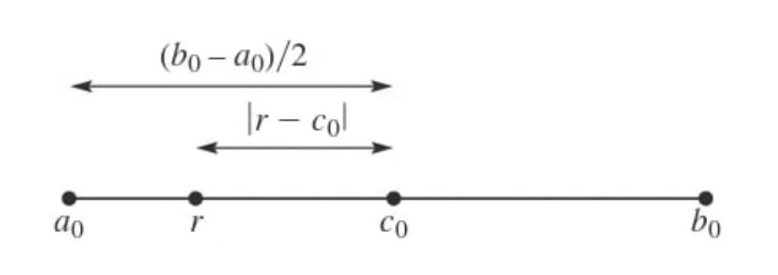
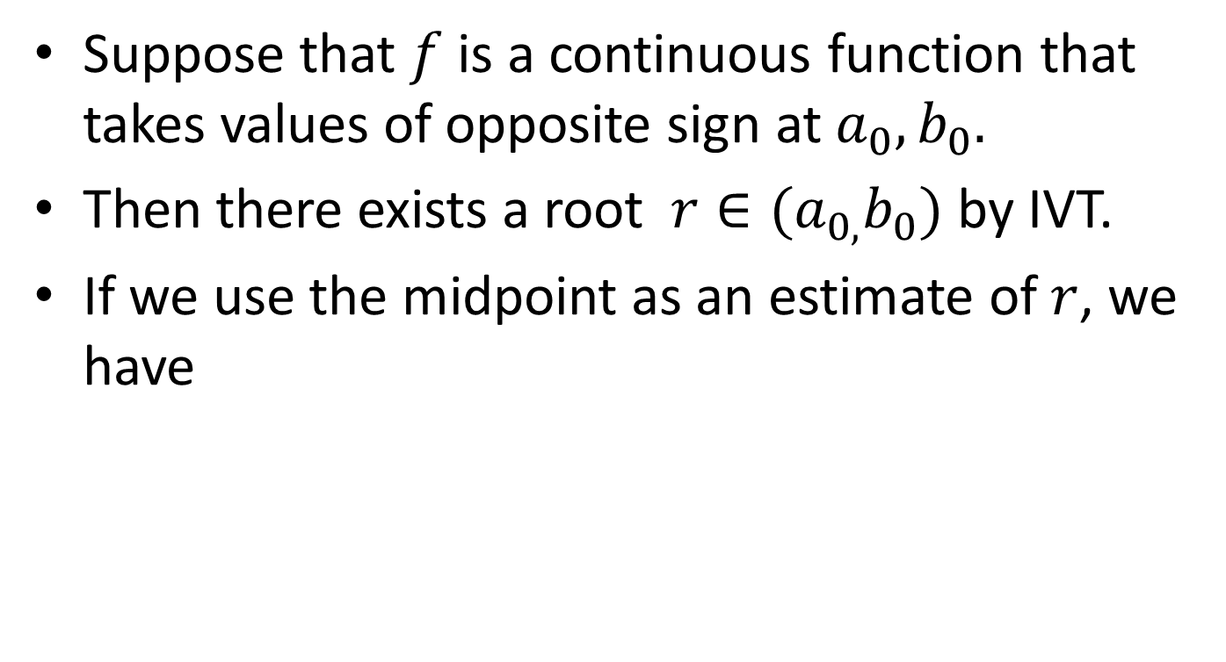
Analysis
Suppose that $f$ is a continuous function that takes values of opposite sign at $a_{0}, b_{0}.$
Then there exists a root $r∈(a_{0,}b_{0})$ by IVT.
If we use the midpoint as an estimate of $r$, we have

Slide 10
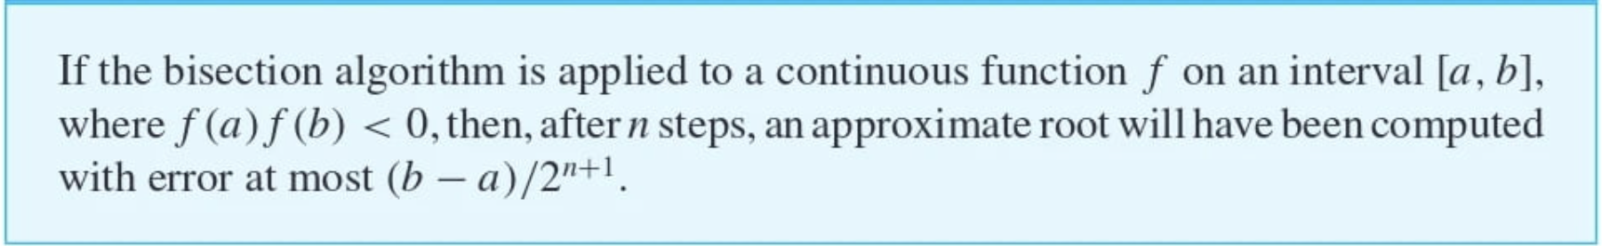
Convergence Theorem
If error tolerance is prescribed, the number of steps can be calculated.
The root sought by bisection depends on initial interval and the solution may not be unique.
Often the bisection method is used to get close to the root before switching to a faster one.

Slide 11
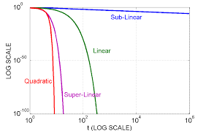
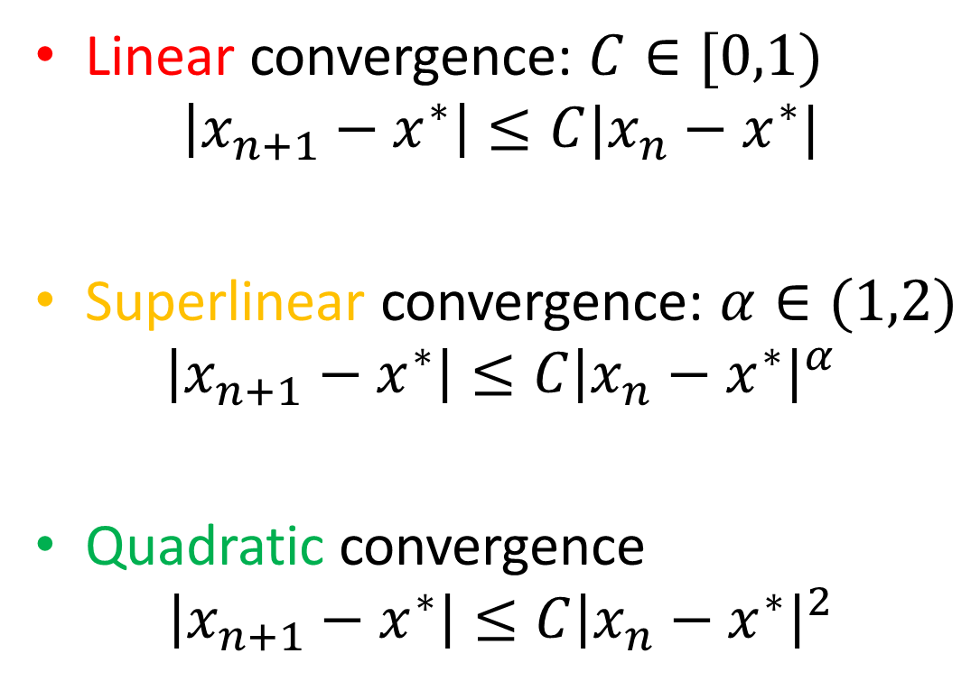
Convergence rate
Linear convergence: $C∈[0,1)$
$$\left|x_{n+1}−x^{∗}\right|≤C|x_{n}−x^{∗}|$$
Superlinear convergence: $α∈(1,2)$
$$\left|x_{n+1}−x^{∗}\right|≤C{\left|x_{n}−x^{∗}\right|}^{α}$$
Quadratic convergence
$$\left|x_{n+1}−x^{∗}\right|≤C{\left|x_{n}−x^{∗}\right|}^{2}$$

Slide 12
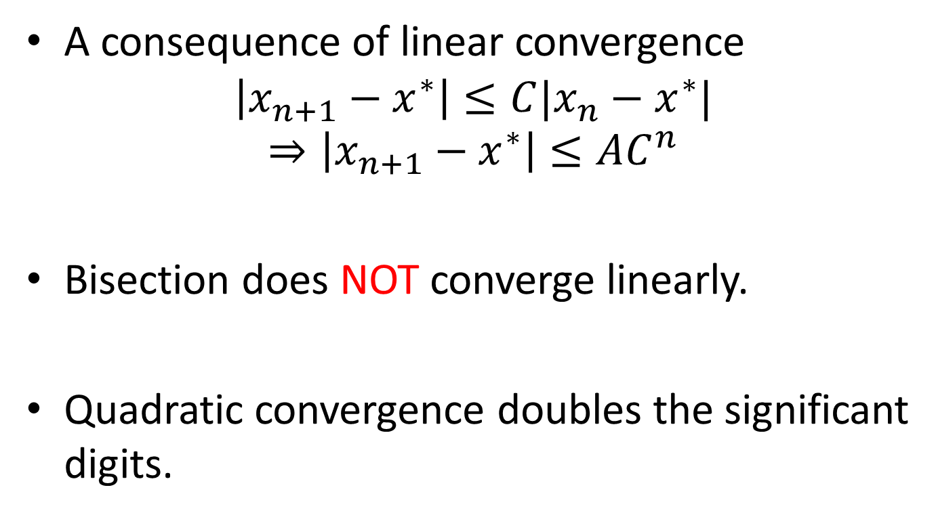
Convergence rate (cont’d)
A consequence of linear convergence
$$\left|x_{n+1}−x^{∗}\right|≤C|x_{n}−x^{∗}|$$
$$⇒\left|x_{n+1}−x^{∗}\right|≤AC^{n}$$
Bisection does NOT converge linearly.
Quadratic convergence doubles the significant digits.

Slide 13
Bisection variants

Slide 14
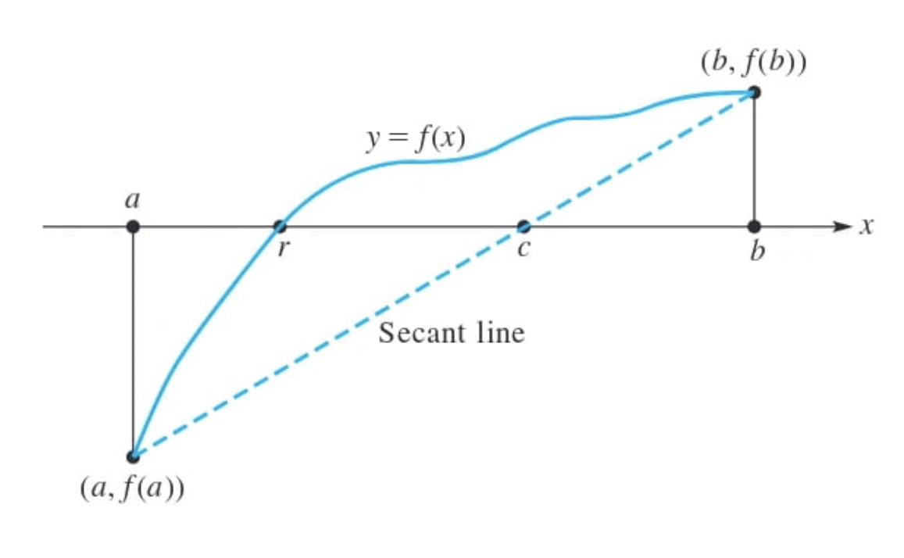
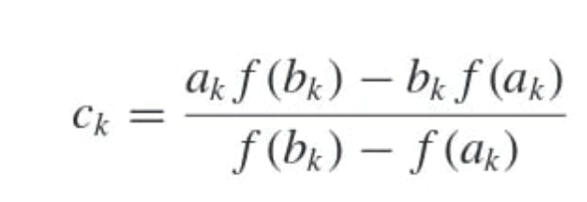
False position method
Rather than selecting the midpoint, this method uses the point where the secant lines intersect the x-axis.

Slide 15
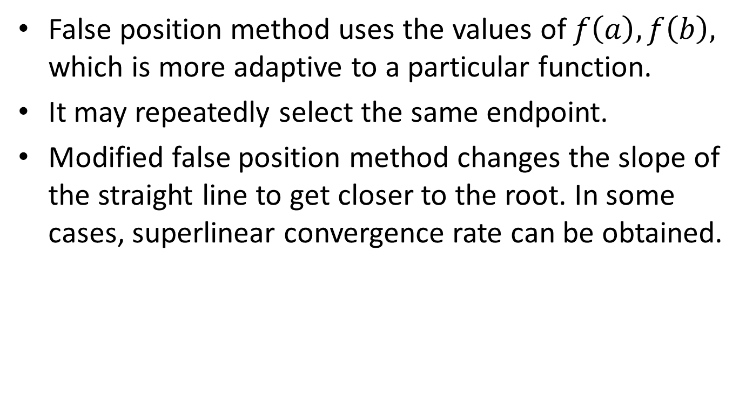
Remarks
False position method uses the values of $f\left(a\right), f\left(b\right),$ which is more adaptive to a particular function.
It may repeatedly select the same endpoint.
Modified false position method changes the slope of the straight line to get closer to the root. In some cases, superlinear convergence rate can be obtained.

